Slide 1
MULTIPLEXING
Name- Soumen Pal
Roll No-16800117018
Year- 3rd
Sem- 6th

Slide 2
What Is Multiplexing?
Multiplexing is a technique used to combine and send the multiple data streams over a single medium. The process of combining the data streams is known as multiplexing and hardware used for multiplexing is known as a multiplexer.

Slide 3
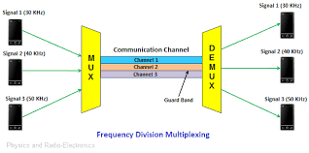

Slide 4
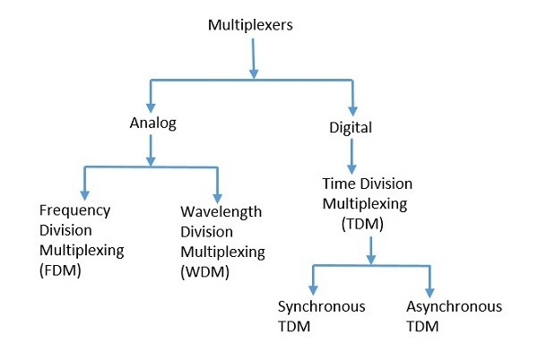
Types of Multiplexers

Slide 5
How works Analog Multiplexing?
The signals used in analog multiplexing techniques are analog in nature. The analog signals are multiplexed according to their frequency (FDM) or wavelength (WDM)

Slide 6
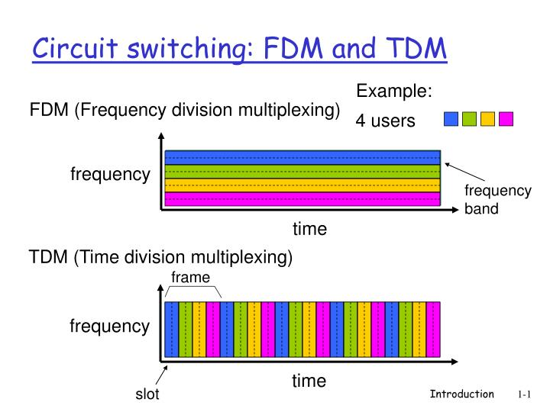
Fdm vs Tdm

Slide 7
Frequency Division Multiplexing (FDM)
This type of multiplexing is useful when the link’s bandwidth is better than the United bandwidth of the transmitted signals.
In FDM, signals are produced by transmitting various device modulated carrier frequencies, and then these are united into a solo signal which can be moved by the connection. To hold the adapted signal, the carrier frequencies are divided by sufficient bandwidth, & these ranges of bandwidths are the channels through the different traveling signals. These can be divided by bandwidth which is not used. The best examples of the FDM comprise signal transmission in TV and radio.

Slide 8
Time Division Multiplexing (TDM)
TDM is mainly useful for analog and digital signals, in which several channels with low speed are multiplexed into high-speed channels used for transmission. Depending on the time, every low-speed channel will be assigned to an exact position, wherever it works in the mode of synchronized. Both the ends of MUX and DEMUX are synchronized timely & at the same time switch toward the next channel.

